Slide 1



Real-Time Ride & Cancellation Monitoring
View in Power BI
Last data refresh:
9/28/2025 11:50:01 AM UTC
Downloaded at:
9/28/2025 11:56:03 AM UTC
Notes:
INTRODUCTION
The goal of this dashboard is to track ride performance, customer behaviour, and operational efficiency in real time. It provides a clear view of ride demand, payment preferences, booking outcomes, and vehicle usage, helping stakeholders identify growth opportunities, reduce cancellations, and improve customer satisfaction. By turning raw data into actionable insights, this dashboard supports smarter decision-making and drives business performance.

Slide 2
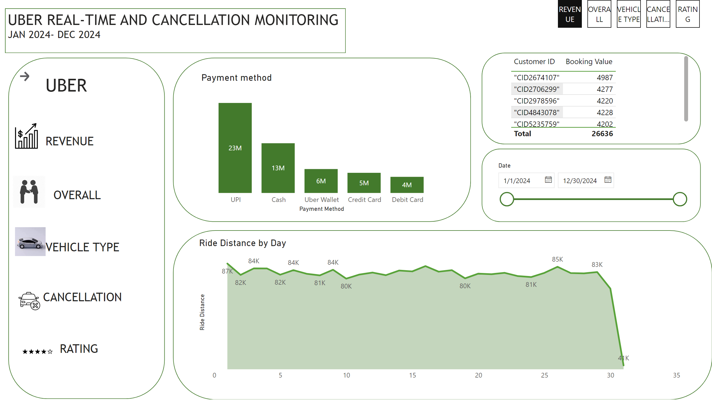
REVENUE
Notes:
UPI is far the most popular payment method, followed by Cash, Uber wallets and cards lagging.
Daily rides hover around 80-85k, but there is noticeable dip towards the end of the month.
Customer ID CID26744107 has the highest booking value.
Recommendation
Maintain current payment options
- Consider loyalty perks by method
- Log payment method per ride for refund traceability

Slide 3
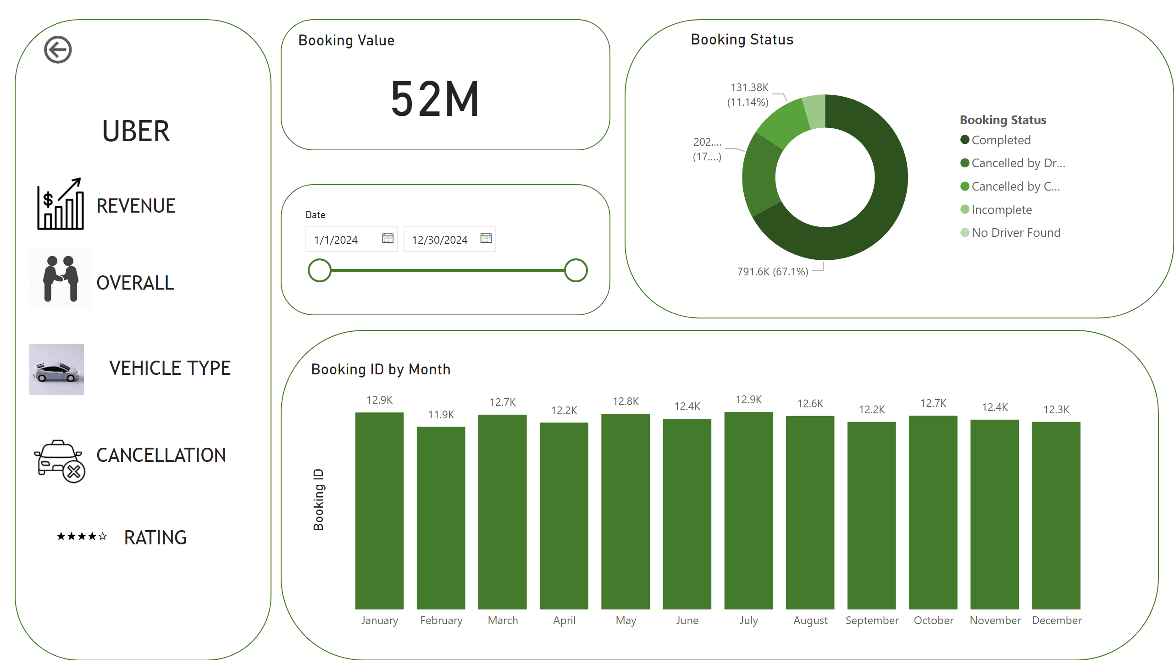
OVERALL

Slide 4
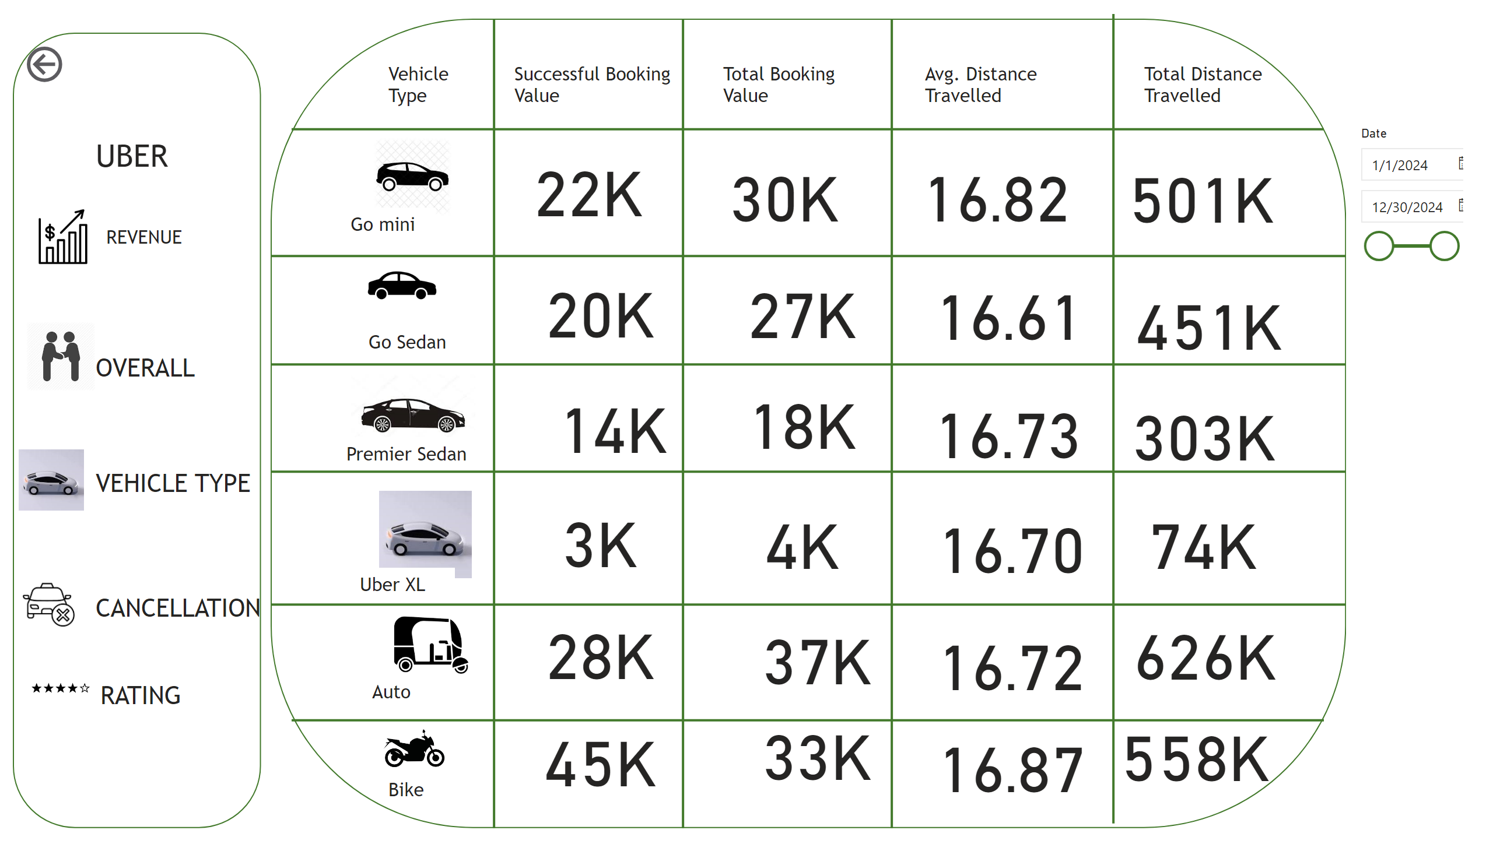
VEHICLE TYPE

Slide 5
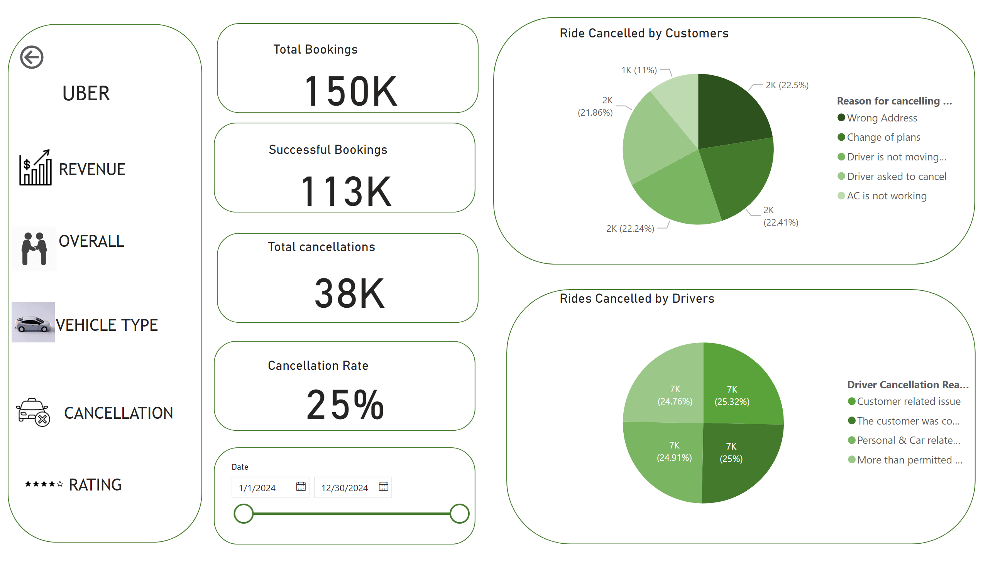
CANCELLATION

Slide 6
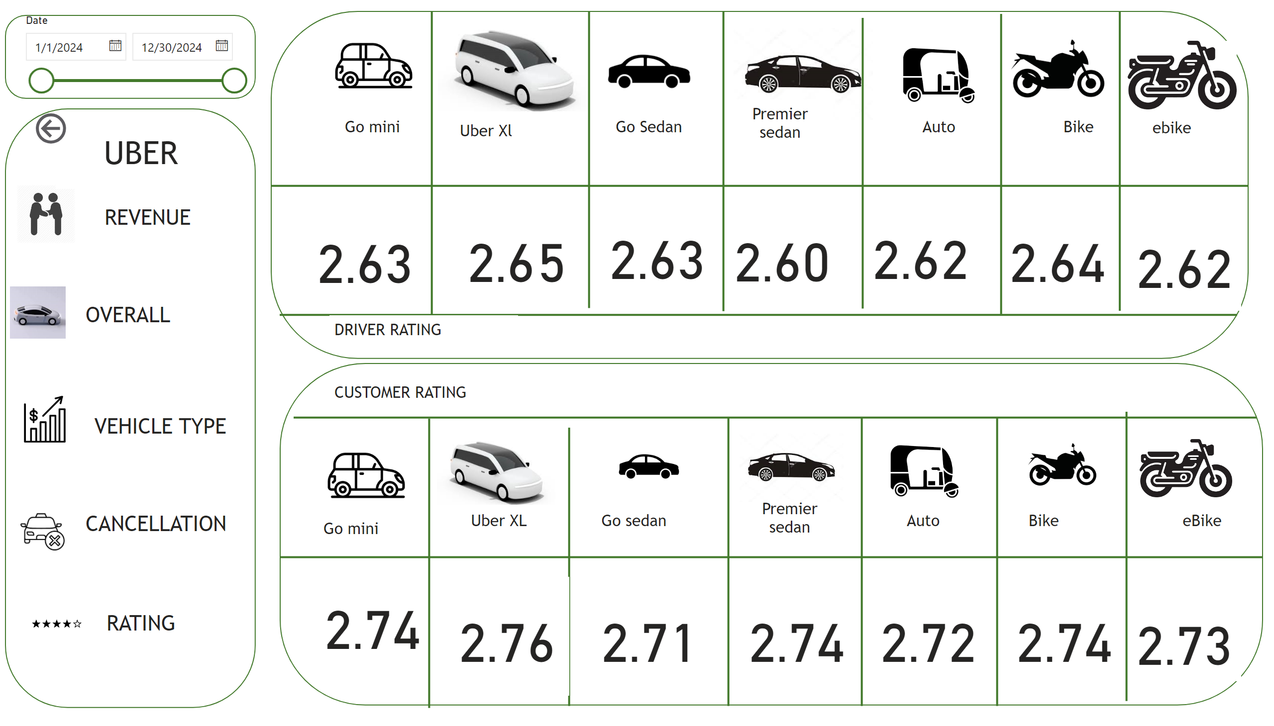
RATING

Slide 7
RECOMMENDATIONS
UPI is far the most popular payment method, followed by Cash, Uber wallets and cards lagging.
Daily rides hover around 80-85k, but there is noticeable dip towards the end of the month.
Customer ID CID26744107 has the highest booking value.
Recommendation
Maintain current payment options
- Consider loyalty perks by method
- Log payment method per ride for refund traceability
Booking Value: £52M Strong overall performance
- Booking Status:
- 67.1% completed
- 17% cancelled by drivers
- 11.14% cancelled by customers
Monthly Bookings: Consistent across all months stable demand

Slide 8
Recommendation
Maintain current fleet and supplier mix due to stable monthly bookings
Investigate driver side cancellations (17%) and log causes into scenario cards
Monitor booking completion rate (67.1%) to ensure supplier reliability
Use governance notes to track trends and guide supplier accountability
Document refund triggers and dispatch delays for audit clarity
Vehicle Type Performance
- Prioritize Go Sedan and Go Moto for expansion
- Reassess Go SUV’s pricing or route strategy
- Monitor cancellation ratings for high-performing vehicles
Booking & Cancellation
- Investigate high cancellation rate (25%)
- Log cancellation reasons into scenario cards
- Optimize dispatch and reallocate fleet during peak hours
Ratings & Revenue
- Leverage high ratings to identify loyalty segments
- Explore upsell opportunities for low-revenue, high-rating rides
- Track supplier quality through rating-linked scenario cards

Slide 9
THANK YOU

